Slide 1
WELCOME BACK
AND
CONGRATULATIONS ON YOUR DESIGN WORK SO FAR!
You are idea people!!

Slide 2
TODAY
Display your fashion design on the back wall, using two drafting dots. Look at other work.
Critique Team 0-P
START MAKING A BOX THAT WILL BECOME A CULTURAL RESTAURANT INSIDE AND OUT.
Today we will work on the Cultural Restaurant exterior.

Slide 3
MEANWHILE
We will also work in teams and set up the interior design students, Tiny Office projects for gallery design experience.
First take down your gallery design work in BH 334 and take home today.
I will assign you, in teams, to hang the Tiny Office projects with T pins.
You will need to decides the best project and hang them “with good design principles” i.e., straight, neat, good spacing, etc.

Slide 4
REVIEW: FIRST MAKE A
10” X 10” X 5” BOX
USE CARD STOCK OR MUSEUM B.
MEASURE AND DRAW SIDES WITH A PENCIL AS SHOWN IN CLASS
CUT OUT THE SIDES WITH AN X-ACTO KNIFE OR A PAPER CUTTER FOR CLEAN EDGES
YOU CAN SCORE AND FOLD OR GLUE ALL SIDES WITH HOT WAX OR A GOOD GLUE. MODEL MAKING TAPE USED ON THE INTERIOR IS ANOTHER OPTION.

Slide 5
YOUR BOX WILL BECOME AN EXTERIOR AND INTERIOR OF A CULTURAL RESTAURANT
SO YOU MUST LEAVE ONE SIDE OPEN FOR NOW
AND PLAN A PEEP HOLE ON ONE SIDE
YOU WILL RESEARCH A CULTURE AND APPLY A PATTERN FROM THAT CULTURE TO THE EXTERIOR OF THE BOX

Slide 6

NEXT CLASS BRING YOUR BOX AND PAINTING SUPPLIES TO CLASS WITH AN IDEA OF HOW YOU WILL DESIGN YOUR BOX. YOU MUST WORK IN CLASS ON THIS PROJECT.

Slide 7
AN EXAMPLE OF A CULTURAL PATTERN:

Slide 8
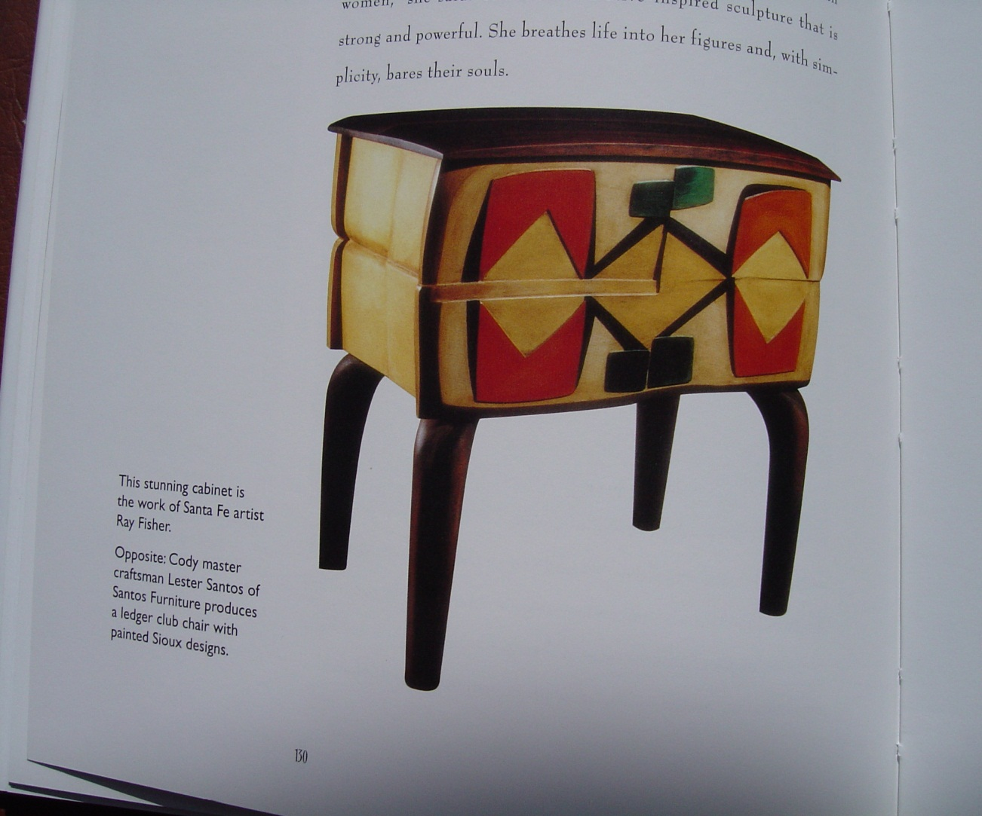
NATIVE AMERICAN PATTERN AND FURNITUE DESIGN

Slide 9
ROAD MAP FOR TODAY:
Assignment #6-CULTURAL PATTERN BOX
CREATE A PATTERN THAT MIGHT REPRESENT YOUR CHOSEN CULTURE AND PAINT IT ON THE EXTERIOR OF THE BOX.

Slide 10
YOUR BOX WILL BECOME THE EXTERIOR OF A RESTAURANT BUILDING. GIVE YOUR RESTAURANT A NAME. WRITE THE NAME ON THE BOX USING REPRESENTATIVE AND APPROPRIATE LETTERING-FONT.
IN THE NEXT WEEKS WE WILL DESIGN THE INTERIOR OF THE BOX BUT FOR NOW WE NEED A PEEP HOLE TO SEE INTO THE INTERIOR. CUT A PEEP HOLE ON ONE SIDE; MAKE A NEAT AND CLEAN CUT.

Slide 11
YOUR PATTERN DESIGN CAN BE:
PART OF THE PEEP HOLE
IT CAN BE A BRAND
IT CAN BE A HORIZONTAL LINE OR BAND AROUND THE BOX
IT CAN BE PART OF THE LETTERING THAT YOU CHOOSE

Slide 12
OBJECTIVES
COLOR PERCEPTION
CULTURAL COLORS AND PATTERNS
LETTERING
BRANDING
EXTERIOR 3-D DESIGN

Slide 13
CHANGE OF HOMEWORK DUE 4/6.
WITH A PENCIL, DRAW THE FOLLOWING ON THE OUTSIDE OF THE BOX:
1. PATTERN WITH A CULTURAL THEME
2. LETTERING--NAME OF RESTAURANT
3. THEN PLAN HOW YOU WILL PAINT THE PATTERN, LETTERING AND THE EXTERIOR OF THE BOX.
DO NOT PAINT YOUR BOX UNTIL YOU COME TO CLASS.

Slide 14
THINK ABOUT THE INTERIOR OF YOUR BOX AND HAVE A BASIC SKETCH READY TO SHOW ME--
BRING ALL PAINT SUPPLIES AND THE BOX TO CLASS ON 4/6. YOU WILL PAINT IN CLASS. YOU NEED TO HAVE YOUR SUPPLIES.
I WILL COME AROUND AND SEE WHAT YOUR PLANS ARE FOR THE EXTERIOR AND THE INTERIOR.
DO NOT SEND ME EMAILS OF THE EXTERIOR OF THE BOX AND CRITIQUES UNTIL 4/20.

Slide 15
WE WILL USE YOUR BOX FOR ASSIGNMENT #7, A RESTAURANT INTERIOR SPACE.
MAKE AN INTERIOR SPACE IN YOUR BOX. YOU WILL BE MAKING AN ABSTRACT INTERIOR RESTAURANT ROOM BY ADDING LIGHT, COLOR, FUNISHINGS AND ARCHITECTURAL DETAIL TO ESTABLISH AN AESTHETIC CULTURAL SPACE.
I WILL SHOW YOU SOME EXAMPLES OF RESTAURANT INTERIORS.
REMEMBER TO VISIT A RESTAURANT AND STUDY THEIR LIGHTING AND COLOR.

Slide 16
NCP
SHARE YOUR RESTAURANT EXPERIENCE.

Slide 17
USE ANY LED PORTABLE LIGHTING WITHOUT ELECTRICITY.
Review Chapter 10 and READER ON ILEARN on “Interior Design” and “Miscellaneous Information To Use When Selecting Color for Interiors” as your guide.
LIGHTING IDEAS:
OUTSIDE LIGHT THROUGH FENESTRATION ETC.
INSIDE LIGHT WITH USE OF TINY FLASHLIGHTS,
COLORED LIGHTING WITH COLORED BULBS OR LIGHT SHINING THROUGH COLORED TRANSPARACIES.

Slide 18
Make at least two interior forms out of white card stock that is:
1. an architectural treatment, for example: a column or stairs
2. a furnishing, for example: a table or chair.
Keep in mind the scale and proportion of the form in relationship to the interior space. ½’=1’-0” WILL BE A GOOD SCALE. THAT WOULD MAKE YOUR INTERIOR 20’X20’ AND 10’ FLOOR TO CEILING.

Slide 19
In your critique, explain why you chose the colors, forms, light, etc. that you did.

Slide 20
OBJECTIVES:
LETTERING AND GRAPHICS
ARCHITECTURAL AND INTERIOR DESIGN ELEMENTS AND PRINCIPLES
USE OF LINE, SCALE, PROPORTION CONCEPTS

Slide 21
AN EXAMPLE
OF LIGHT DESIGN IN AN INTERIOR SPACE

Slide 22
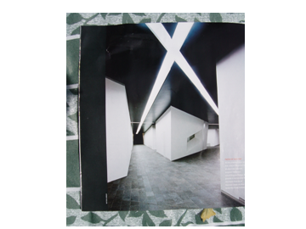
LIGHT PATTERNS IN INTERIOR ARCHITECTURE

Slide 23
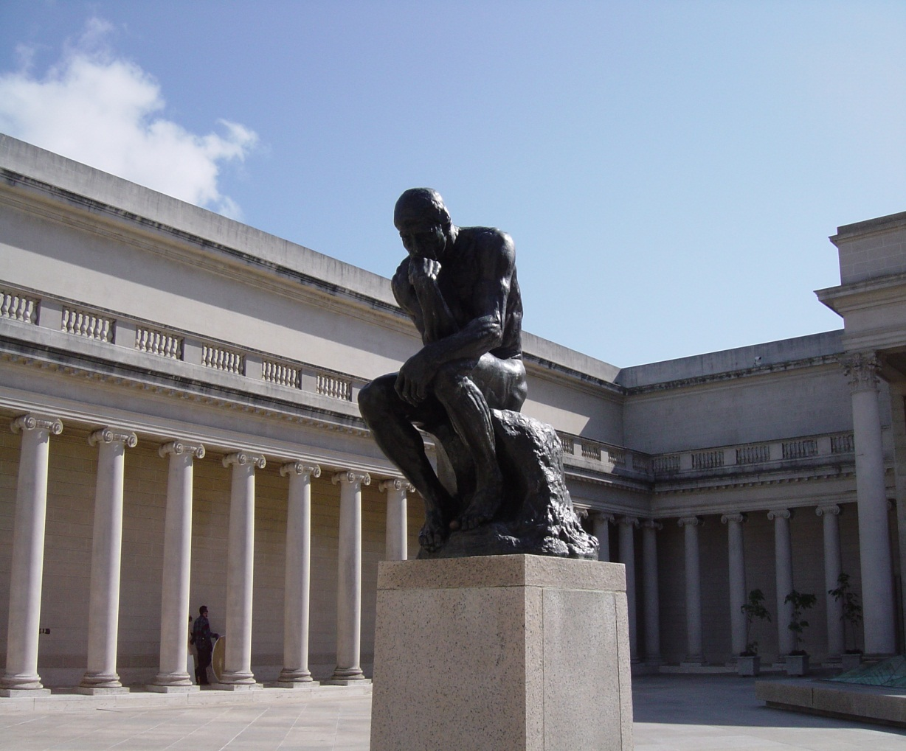
START THINKING

Slide 24
I WILL DESK CRIT AND DISCUSS YOUR BOX EXTERIOR PLANS AND LOOK AT FOLDERS THROUGHOUT THE CLASS

Slide 25
AT 6:15 WE WILL CLEANUP AND DISCUSS YOUR FINAL PROJECT
HERE ARE SOME EXAMPLES OF BOXES AND NEXT MOSAIC PROJECT

